Slide 1

Modern Control Theory
Lecture No. 15
Understanding the Bayesian Process
Casting the Kalman Filter in a Bayesian Framework

Slide 2
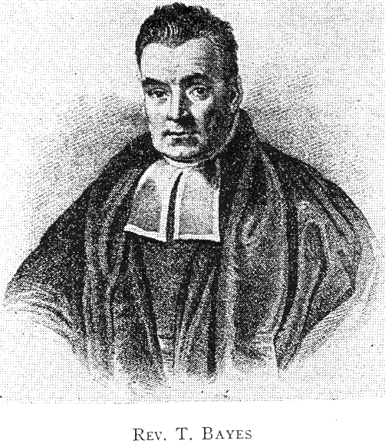
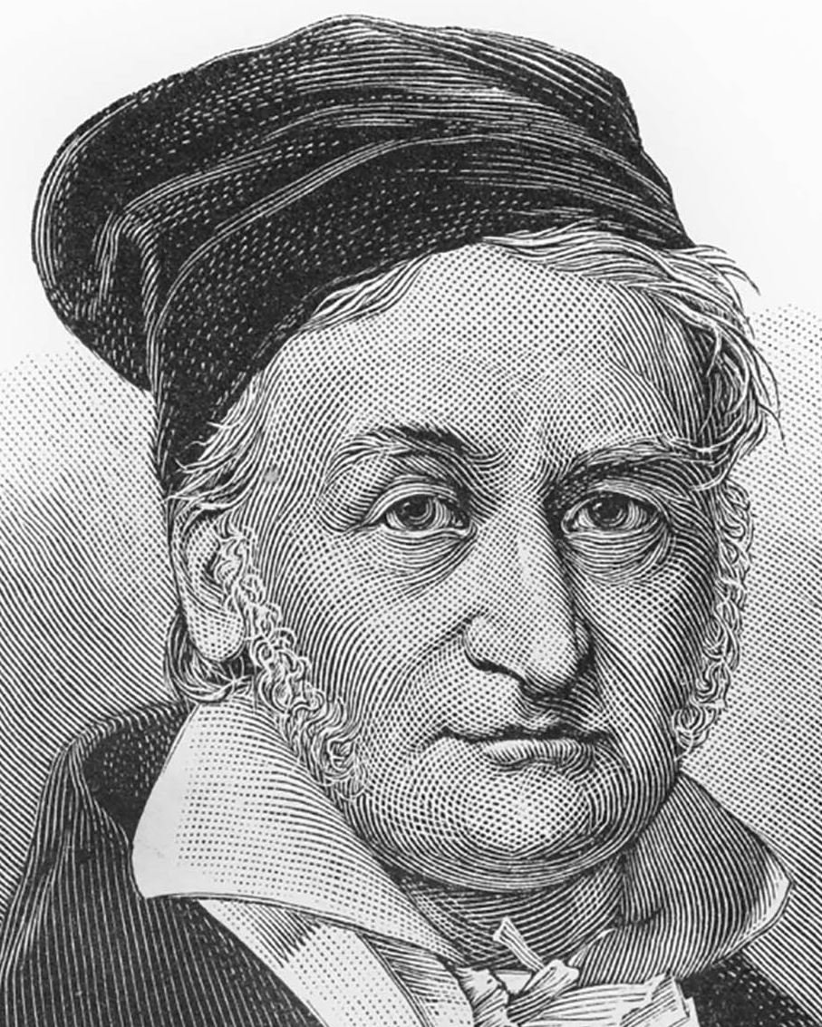
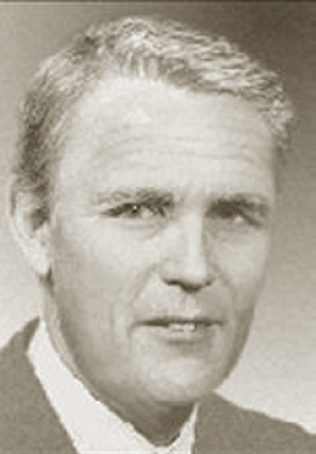

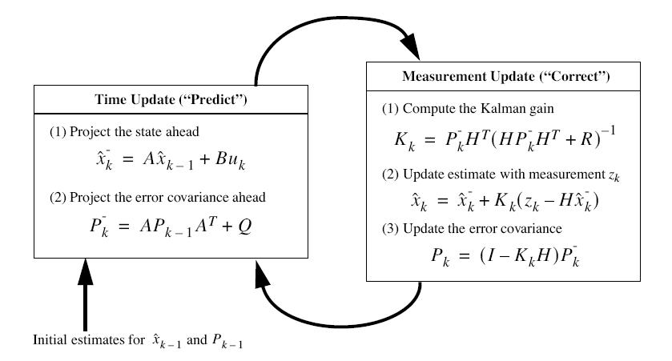
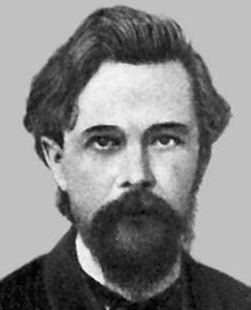
The Kalman Filter

Slide 3
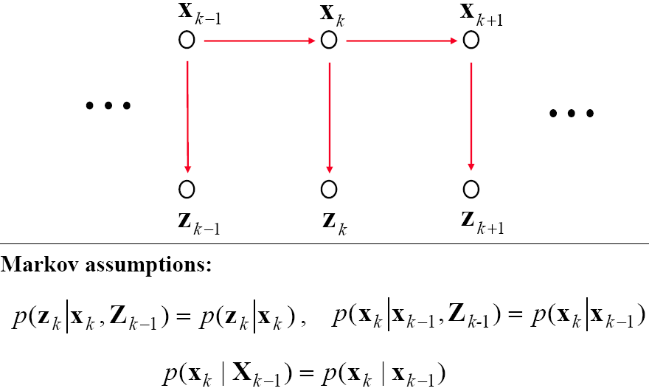
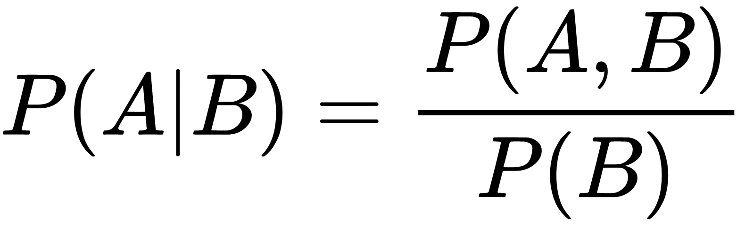


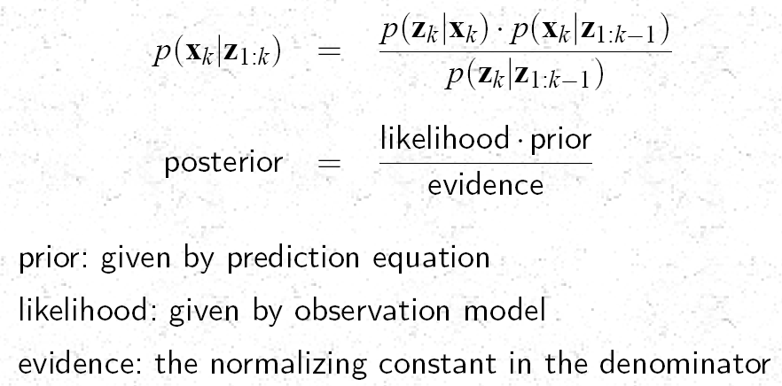
Kalman Filter as a Bayesian Estimator

Slide 4
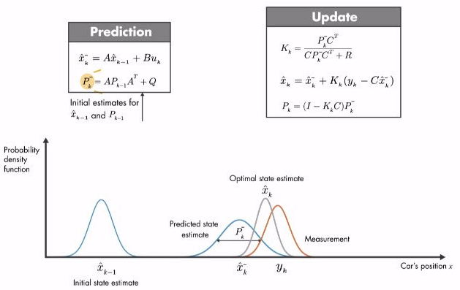


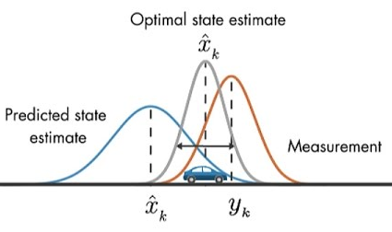
Propagation of a Conditional Density Function

Slide 5



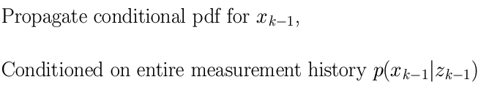
Kalman Filter --- A Bayesian Approach
Update
Prediction
(k-1)+
(k)-
(k)+
k-1
k
z(k-1)
z(k)

Slide 6
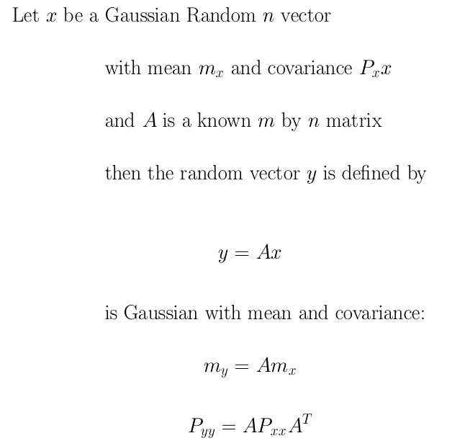
Linear Transformations on a Gaussian Random Variable

Slide 7
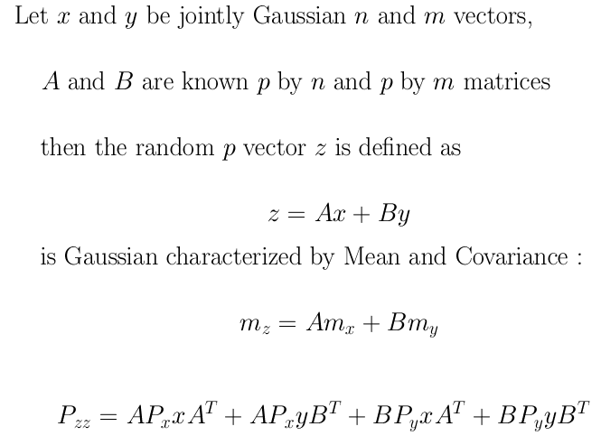
Linear Combinations of Jointly Gaussian Random Variables are also Gaussian

Slide 8
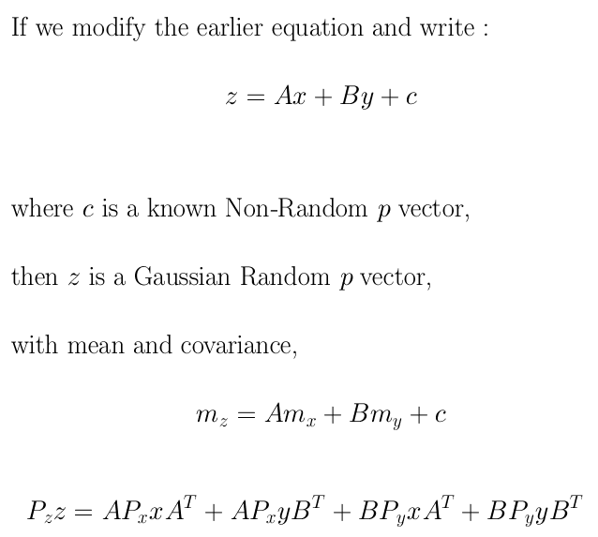
Linear Combinations of Jointly Gaussian Random Variables & Non-Random Vectors are also Gaussian Random Variables

Slide 9
Components in a Bayesian Approach
State Vector : x_{k}
Measurement Vector: z_{k}
Initial pdf: p(x₀)
Likelihood pdf: (from model) p(z_{k}|x_{k})
Prior pdf: p(x_{k}|z_{1:k-1})
Posterior pdf: p(x_{k}|z_{1:k} )

Slide 10
Structure of the Update Equation

Slide 11
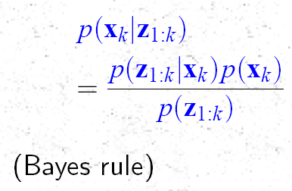
Application of Baye’s Rule

Slide 12
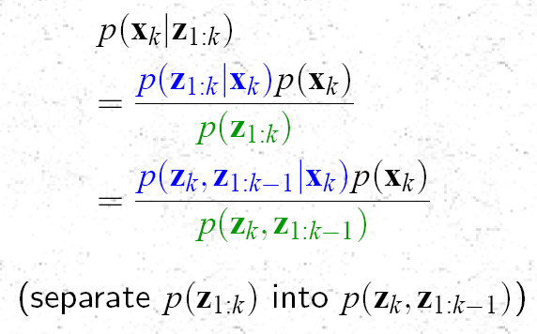

Slide 13
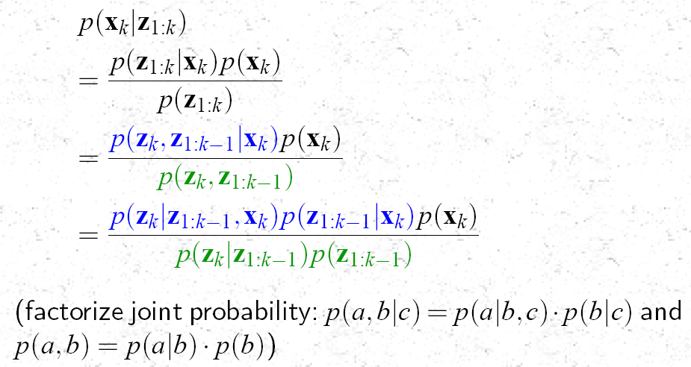

Slide 14
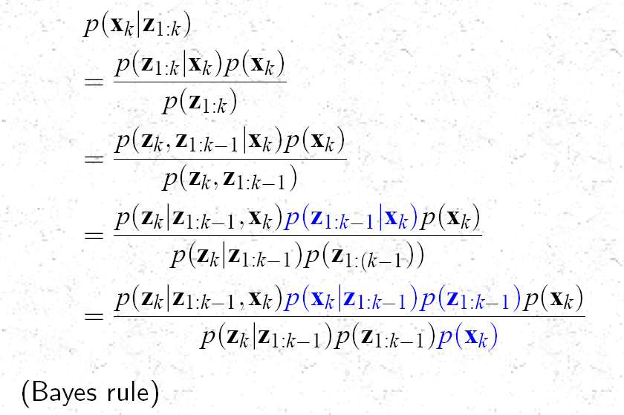

Slide 15
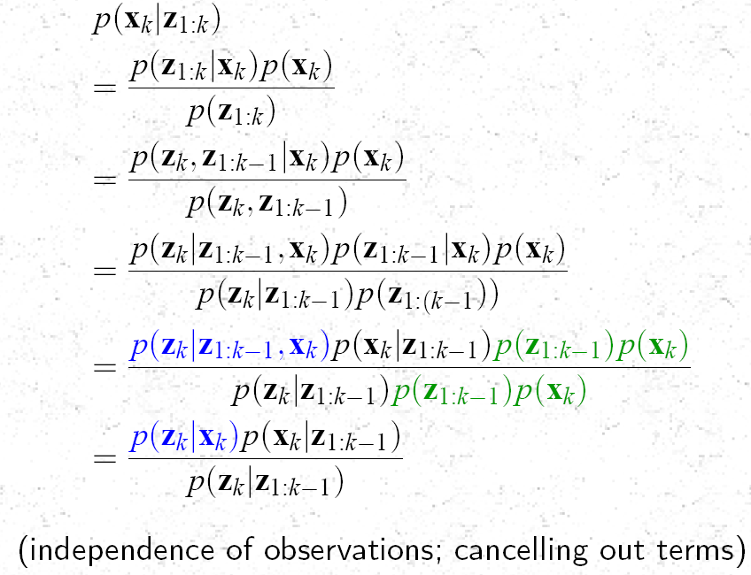

Slide 16
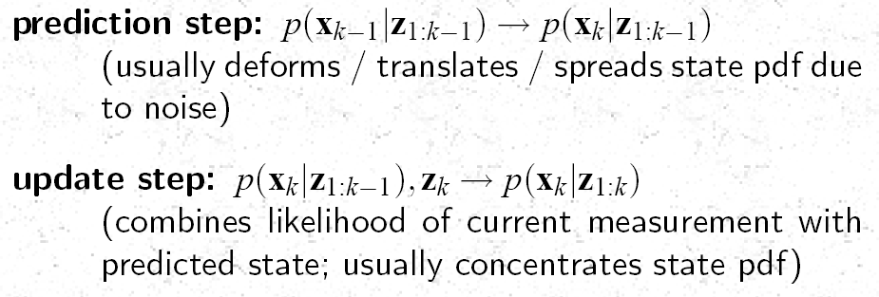
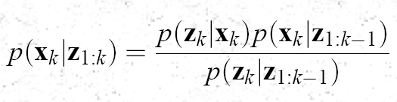
Prediction & Update

